Slide 2
Swift Overview
Swift is a modern open source programming language that runs primarily on iOS, macOS, tvOS and Linux.
Apple initially developed Swift to interoperate with their key frameworks- Cocoa and CocoaTouch, both of which are mostly implemented in Objective-C.

Slide 3
Programming Paradigms
Swift is a multi-paradigm language that supports the following types of programming:
protocol-oriented
object-oriented
functional
block structured
Swift is built using a modern approach to safety, performance, and software design patterns. Hence code written in Swift is faster, safer and expressive.

Slide 4
IBM Swift Sandbox
This course will comprise theoretical concepts explained with examples and Hands-On exercises for you to test your understanding.
Here is a Swift Playground. Using this, you can run Swift code snippets on any browser over the Internet

Slide 5
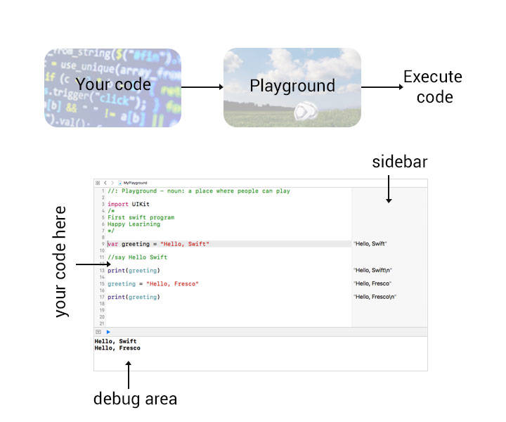
Local Environment
Swift provides a Playground for the purpose of learning, and Xcode is required to use this playground.
If you wish to practice in your local environment, visit Apple Developer Site for downloading Xcode.

Slide 6
Writing your first program
/*
My first program in Swift. Happy Learning!
*/
var greeting = "Hello, Swift"
//say Hello Swift
print(greeting)
greeting = "Hello, Fresco"
//say Hello Fresco
print(greeting)
let program = "My First Program"
print(program)

Slide 7
Understanding your first program
Comments help programmers to understand the code in a better way. Multi line Comments start with /* and ends with */. Single line Comments can be written using double slash (//).
Keywords like var, switch, case, etc are identifiers used by Swift programming language.
Variables & Constants store values in the memory. You can declare a variable using the var keyword and declare a constant using the let keyword. In our program, we stored the string “Hello, Fresco” in the variable greeting.
Semicolon indicates the end of a line or statement in most programming languages. However, Swift does not require a semicolon after each statement.
Print is a built-in function to print value stored in a variable (greeting).

